Slide 1
Jalsutra
A fully managed, cloud based, server-less, and smart irrigation system
By: Sudeep Hazra
sudeephazra@yahoo.com

Slide 2
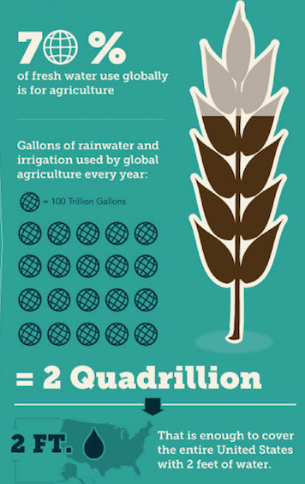
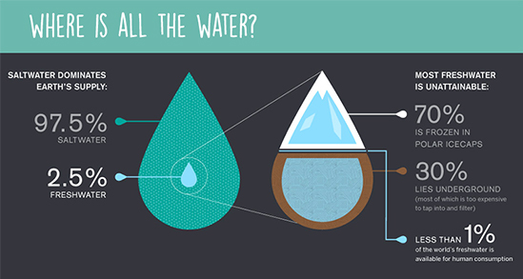
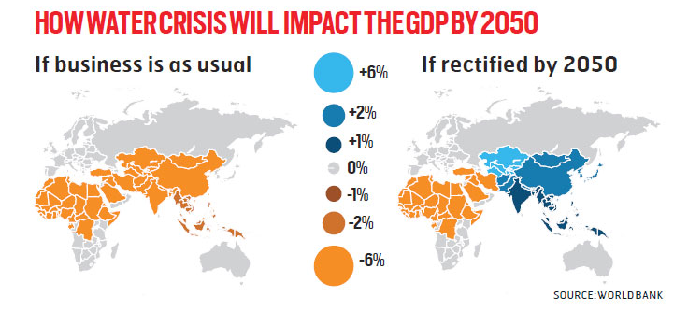
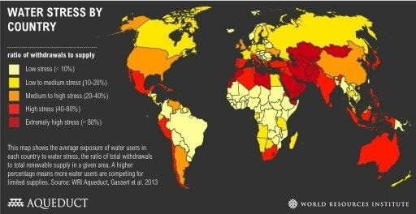
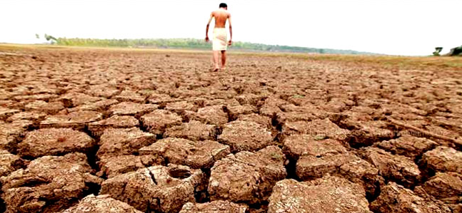
Water Usage

Slide 3
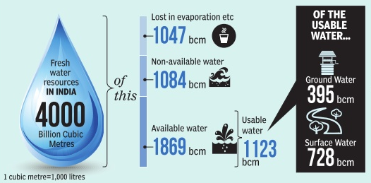
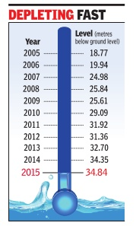
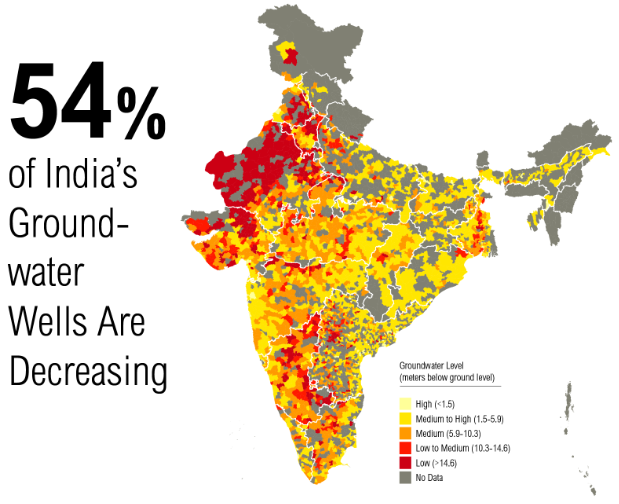
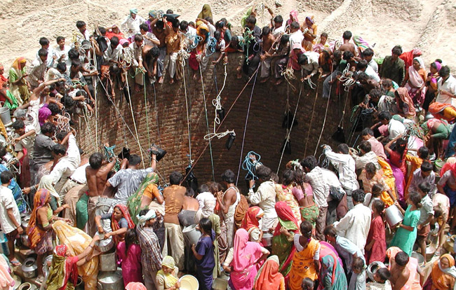
Where does India stand?
An average rural Indian woman walks
1400 km/year
to procure water for her household
Water demand globally is projected to increase by
55%
between 2000 and 2050.

Slide 4
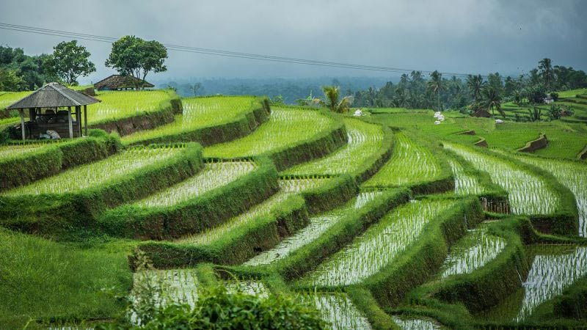
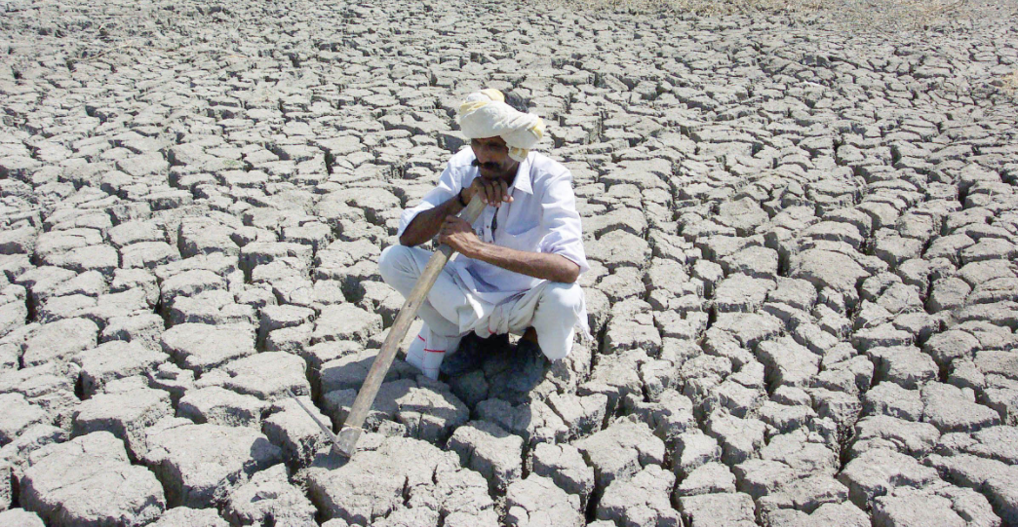
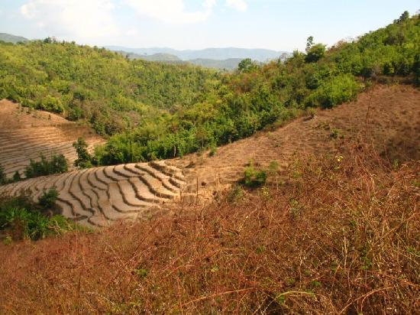
Our Solution – Jal-Sutra
30-70%
water in agriculture can be saved by better irrigation methods
(Source: National Geographic @https://goo.gl/J8dD2H)
We intend to help
farmers, plantations and world governments
save up-to
5,180 Trillion liters
of water each year by using this idea in conjunction with optimal irrigation methods
And we would like to be here
This saving is enough to turn the whole of
Australia
into a huge
rice field
We are here in reality

Slide 5
Introducing Jal-Sutra..
A fully managed, cloud based, server-less, and smart irrigation system
In its current avatar, it has soil moisture, temperature, humidity and rain sensors that send in a continuous data feed into Azure cloud through a Raspberry Pi 3
At the receiving end in the cloud, Azure IoT Hub receives the data from Raspberry Pi 3
The data is then propagated to Azure Stream Analytics to be handled
The temperature and humidity data is then fed to Azure Machine Learning to determine the probability of rain. The ML model uses 2-stage logistics regression to perform rain predictions
The factual data along with the prediction is stored for long time use in Azure SQL database and also displayed on a Power BI dashboard
Depending on the sensor data and predicted values, Azure IoT Hub, Azure Event Hub and Azure Functions are used to control water pumps and drainage valves attached to the Raspberry Pi

Slide 6








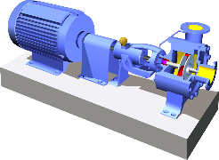


Jal-Sutra – The Architecture
Temperature, Humidity, Soil Moisture and Rain Sensors
Azure Machine Learning Web Service
Azure IoT Hub interfacing with the Raspberry Pi
Azure SQL Database
Azure Stream Analytics
Python 3 based IoT Hub client running on Raspberry Pi 3 for 2-way communication
Power BI Dashboard
Water Pump and Drainage
Azure Function (C#)
Azure Event Hub
Data Acquisition
Analytical and Intelligence Framework
Data Storage and Visualization

Slide 7
What does it do?
Soil moisture, temperature, humidity and rain sensors continuously monitor the environment and interact with Azure based cloud services through a Raspberry Pi 3
If the system detects the soil moisture has dropped below the threshold values, it would check the rain predictions to see if there is a chance of rain
If there is a good chance of rain, the system would wait for rain to replenish the optimal moisture content
In case the chances of rain are not substantial, the system would start to pump in water into the irrigation mechanism to restore the moisture to optimal levels
If it starts raining during the watering process, the system would stop pumping water into the fields
If the system detects sufficient moisture content and it starts raining, the drainage mechanisms would be triggered to drain out the excess water from the field

Slide 8
Direct Cost Impact
For an average farm | Traditional Techniques | Jal-Sutra
Hardware Costs (INR one-time) | N/A | 4000
Irrigation setup (INR one-time) | N/A | 20,000
Cloud Service Cost (INR per year) | N/A | 20,000
Watering cost (INR per year) | 100,000 | 30,000
Total (INR per year) | 100,000 | 74,000
The initial investment will be recovered in the first year itself. After there the first year, there will be 50% recurring cost benefit each year. This is a direct cost benefit over and above the environmental and social benefits. Using specialized hardware would also bring down the initial hardware cost by 75%.

Slide 9
International Water Conflicts
Americas
Columbia River (conflict between Canada and the US)
Africa
Senegal River (conflict between Mauritania and Senegal)
Colorado River (conflict between Mexico and the US)
Senepas River (conflict between Ecuador and Peru)
Zambezi River(conflict between Zambia, Zimbabwe and Botswana)
The sources in the Sahara Desert (Reaction Egypt, Chad, Niger and Sudan)
Nile River (conflict between Egypt and Ethiopia)
Asia
Ganges River (conflict between India and Bangladesh)
Jordan River (the conflict between Israel and Jordan)
Tigris and Euphrates (conflict between Turkey, Syria and Iraq)
Mekong River (conflict between Cambodia, Laos, Thailand and Vietnam)

Slide 10
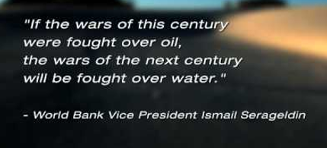
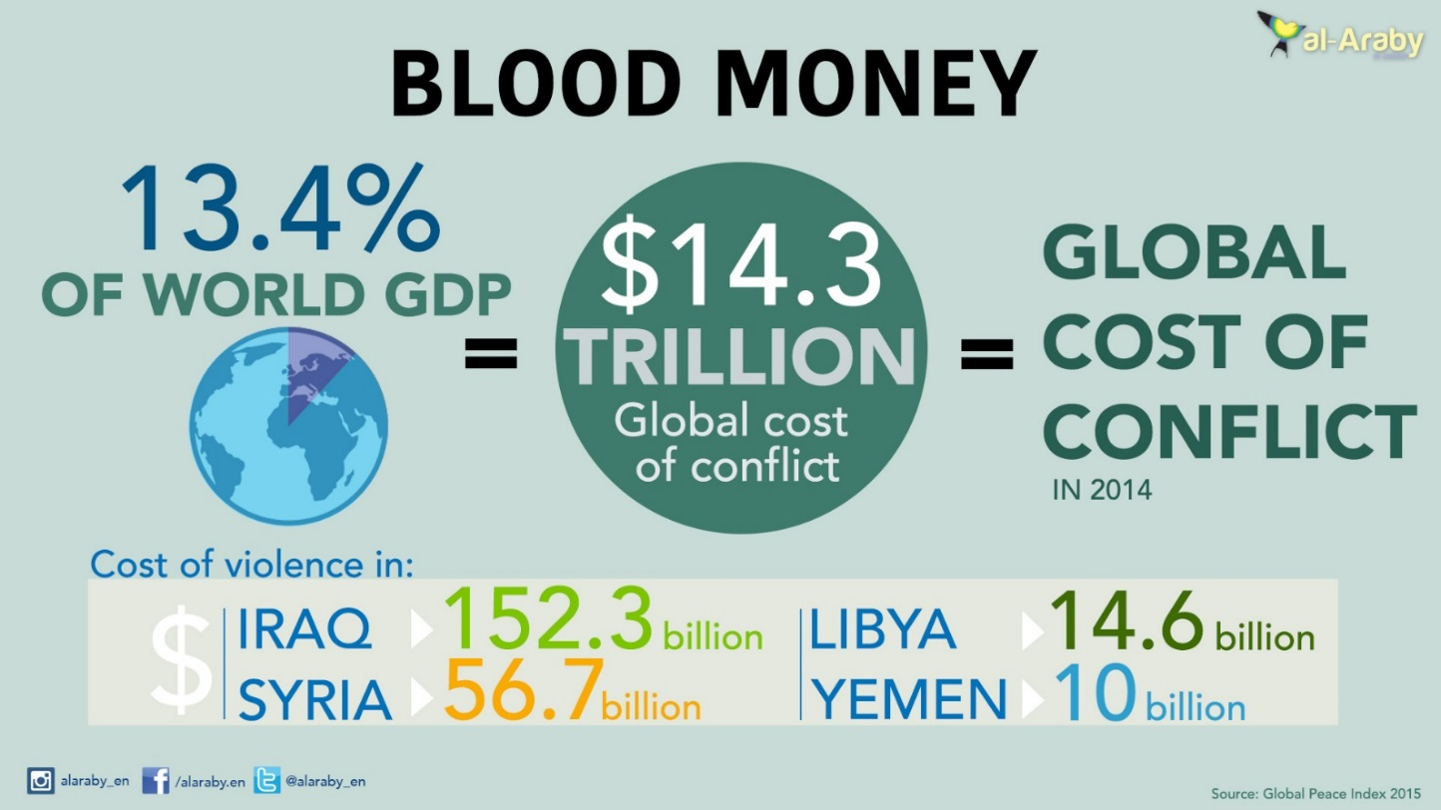
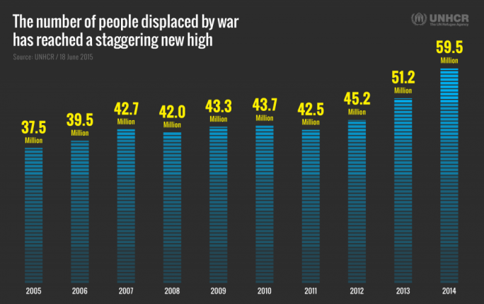
Be Prepared, The War Is Coming
Cost of life =
PRICELESS

Slide 11
Future Roadmap
I intend to expand the solution to take network availability into consideration using a swarm of nodes (low cost microcontrollers viz., ESP8266/ESP32 or Arduino Uno connected with sensors). These micro-controllers can be run off normal batteries for extensive durations using proper deep-sleep/wake-up cycles
All the nodes connect over LoRaWAN (LOw Power Long RAnge Wide Area Network) to a central gateway. Raspberry Pi is used as a gateway and is configured as an IoT Edge device
The gateway receives the data from the nodes and sends it over to Azure cloud (MQTTS) as per the current architecture to perform predictive analysis, reporting and storage. In the absence of a reliable network connection, the Edge device takes over and performs these tasks
The Azure could sends in messages (MQTTS) to the gateway device (Raspberry Pi) to switch on/off the water pump/irrigation switch gates. This functionality is also taken over by the edge device if the network connection is unstable.

Slide 12
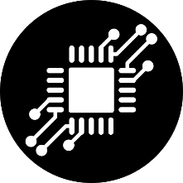
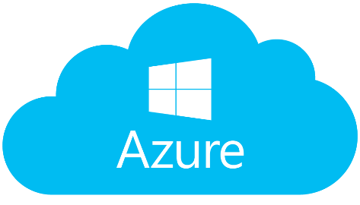
Future Roadmap (contd.)
LoRaWAN
Raspberry Pi
(IoT Edge Device)
ESP 8266/ESP 32

Slide 13
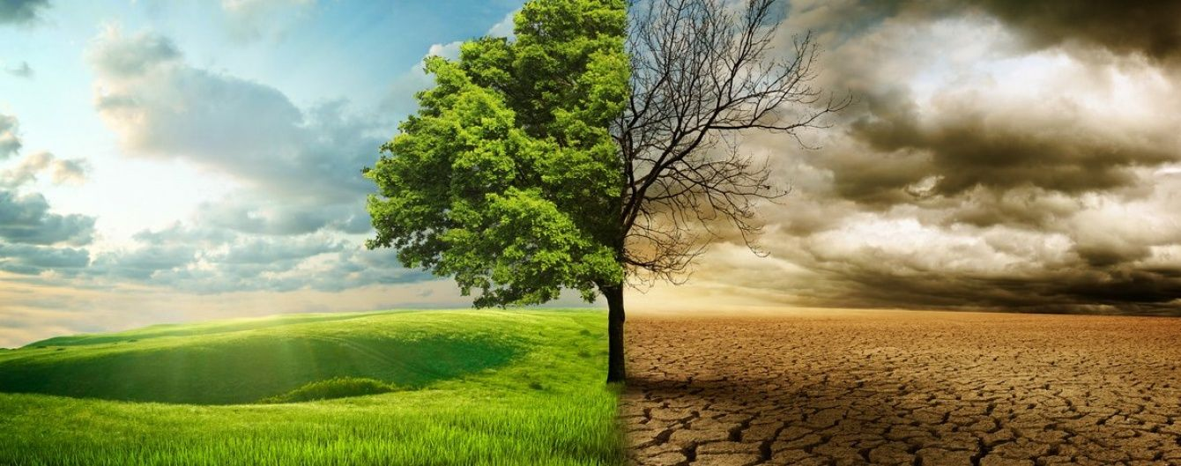
Think about it!!
Really think about it…..

